Slide 1
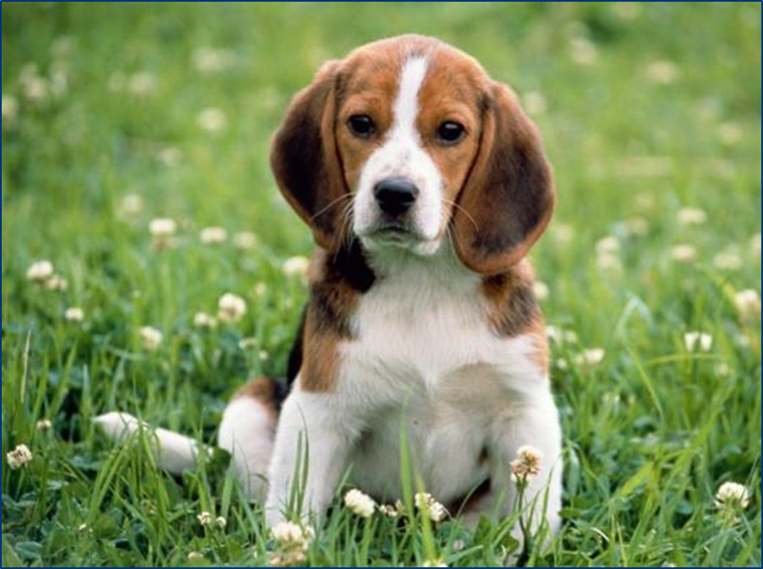
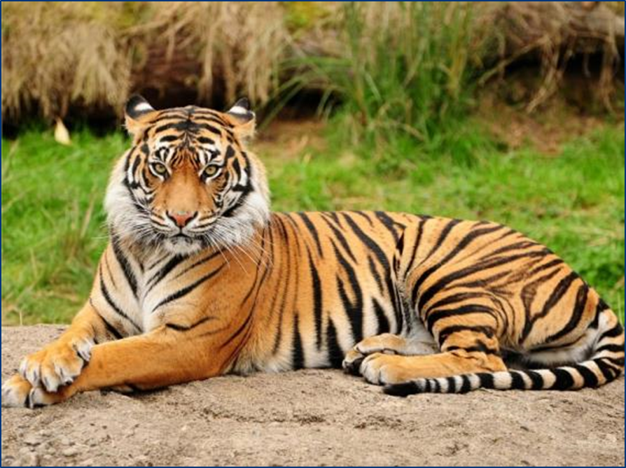
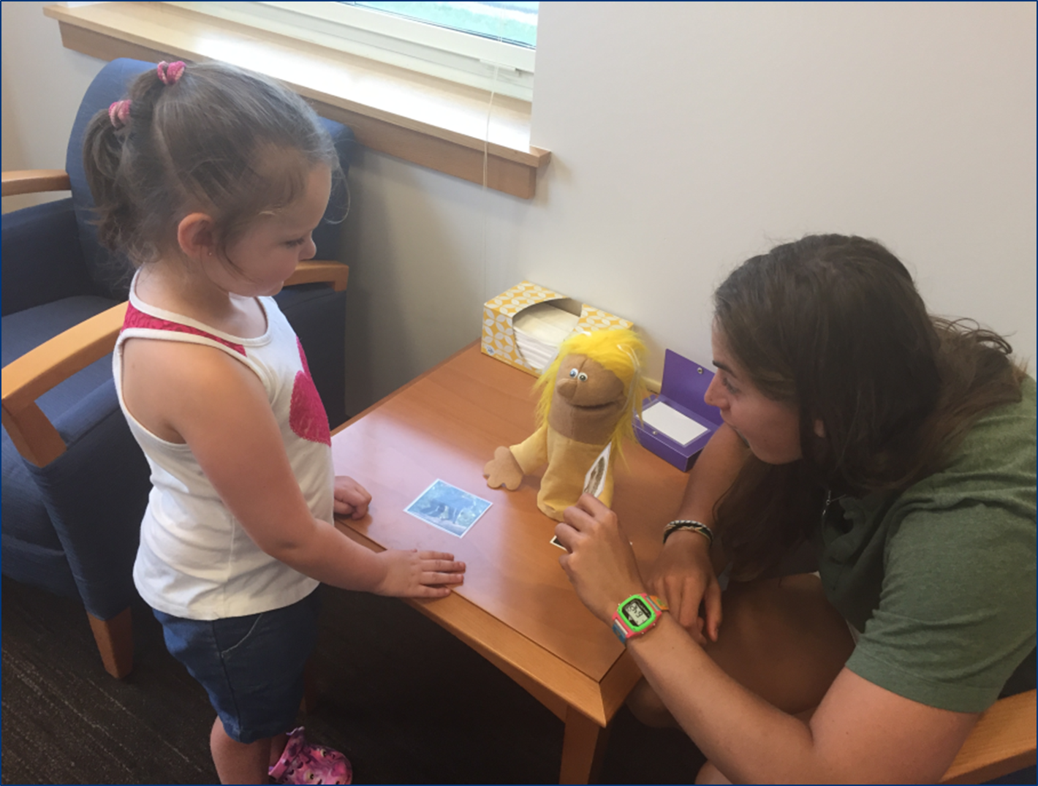
The “Knew-it-all-Along” Error:
Young Children’s Difficulty Tracking Their Own or Another Person’s Knowledge
Bradford H. Pillow and Martha E. Arterberry
Northern Illinois University Colby College
Background
Self condition: In the Self condition, children learned 8 new facts about animals and judged whether they had known each fact prior previously.
For each fact, the experimenter showed children a card with a picture of an animal and read a fact written on the back of the card.
Following Sutherland and Cimpian (2015), children were taught 4 facts about kinds (e.g., “Chimps crack open kernels” “Tigers catch a lot of ruminants”) and 4 facts about individuals (e.g. “This seal sleeps on her dorsal side” “This dog gets sick after eating carbamates”).
After learning the fact, children were asked: “Did you know about this before we read it just now? Before we looked at this picture did you know that _____?”).
Other condition: In the Other condition, children and a puppet were taught a fact, and then the child judged whether the puppet had known it previously. There were 8 new facts about animals, including 4 individual facts and 4 kind facts, and 4 familiar filler items.
Results
A 2 x 2 ANOVA (Person x Item Type) yielded no significant effects.
Performance in the Self and Other condition did not differ significantly, F (1,33) = .58, p > .05.
Performance on individual and kind items did not differ significantly, F (1,33) = .17, p > .05.
Performance did not differ from chance (2 out of 4 correct) in either condition.
The results from Experiment 1 could have been due to children’s confusion about who learned what fact. In Experiment 2, in the other condition, the Experimenter whispered the fact to the puppet, such that the children never heard the information.
Participants and Procedure
4- and 5-year-old children (N = 32; 17 boys; Mage 4 years, 5 months) participated.
Children learned facts about individuals or kinds in one of two conditions (self vs other).
Self condition:
The procedure was the same as in Experiment 1.
Other condition:
Children watched while the experimenter showed pictures to the puppet and whispered facts to the puppet. Thus, whereas the child and puppet received the same knowledge in Experiment 1, in Experiment 2 the child and puppet had contrasting perspectives, with the puppet being knowledgeable and the child remaining uninformed about the facts.
Results
We found the same pattern or results as in Experiment 1. No significant difference between self/other condition and no difference between individual and kind items (all ps > .05). Overall, performance was at chance.
Children’s judgments about when novel facts had been learned did not differ in accuracy for the Self and Other conditions. Thus, difficulty with time of learning judgments appears to be general across both first- and third-person perspectives.
Children may have a general tendency to overlook learning events or fail to relate them to newly acquired knowledge. This tendency may be independent of perspective-specific cues, such as internal cues experienced during the child’s own learning or observation of overt events experienced when witnessing another person’s learning.
Taylor et al. (1994) suggested that children may not attend to learning events. Children’s chance levels of performance indicates general uncertainty about when facts were learned rather than a bias to report that novel facts had been known all along. Thus, when asked to judge how long they had known a particular fact, children appeared guess, randomly choosing one of the two options.
Tang, C. M.. Dickey, S., & Samuelsen, D. (2017). Young children’s
reports of when events occurred: Do event type and assessment method matter? Infant and Child Development, 26, 1-15
Sutherland, S. L., & Cimpian, A. (2015). Children show heightened knew-it-all-along errors when learning new facts about kinds: Evidence for the power of kind representations in children’s thinking. Developmental Psychology, 51, 1115-1130.
Taylor, M., Esbensen, B. M., & Bennett, R. T. (1994). Children’s understanding of knowledge acquisition: The tendency for children to report that they have always known what they have just learned. Child Development, 65, 1581–1604.
Moments after learning a new fact, 4- and 5-year-olds often claim to have previously known it (e.g., Sutherland & Cimpian, 2015; Tang, Dickey, & Samuelsen, 2017; Taylor, Esbensen, & Bennett, 1994).
For example, after learning that cats use their whiskers to judge the size of apertures, or learning the meaning of the word “chartreuse”, children often claimed to have known these facts previously (Taylor et al., 1994).
We examined this “knew-it-all-along” error by comparing children’s monitoring of their own knowledge with children’s tracking of another individual’s knowledge.
Our goal was to examine two alternative possibilities:
Children might make errors when judging their own knowledge more often than when judging another person’s knowledge.
If children have difficulty monitoring metacognitive cues related to their own learning, but can track the overt events involved in observing another individual’s learning, then children might be better at tracking the origins of another individual’s knowledge compared to their own knowledge.
Children might make errors both when judging their own knowledge and when judging another person’s knowledge.
If children have a general difficulty relating knowledge to learning episodes, they may be prone to making errors for both self and other.
Participants and Procedure
4- to 5-year-old children (N = 35; 18 boys; Mage 4 years, 8 months) participated.
Children learned facts about individuals or kinds in one of two conditions (self vs other).
Chance
Chance
Experiment 2
Conclusions
Aims
References
Experiment 1
Correspondence: pillow@niu.edu Poster available at: bradfordpillow.weebly.com

